Slide 1
Linear Regression

Slide 2
Agenda
Understanding Correlation
Assumptions of Linear Regression
Residual Analysis
Least Squares
Simple and Multiple Linear Regression
Evaluation Metrics

Slide 3
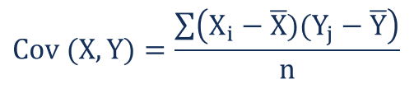

Understanding Correlation

Slide 4
Assumptions of Linear Regression
Linear relationship between features and target variable
Independence of observations
Normality of residuals
Equality of variance - Homoscedasticity
Little or no multicollinearity between the features
Variance Inflation Factor (VIF)
Correlation Matrix

Slide 5
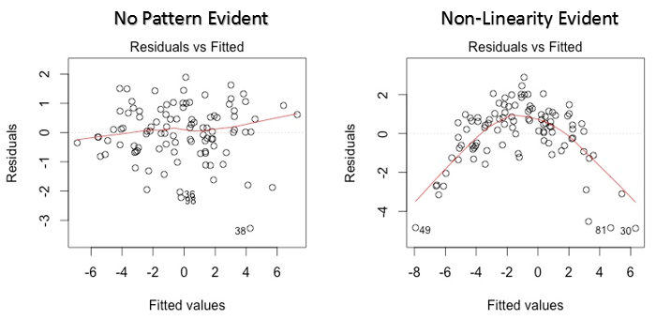
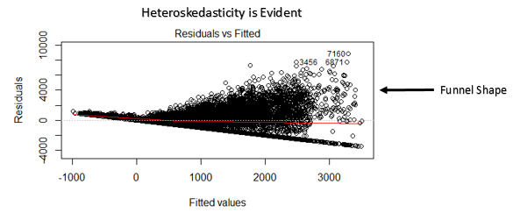
Residual Analysis
Reference - https://www.analyticsvidhya.com/

Slide 6
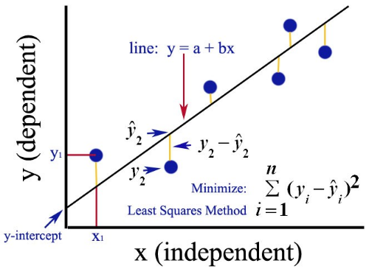
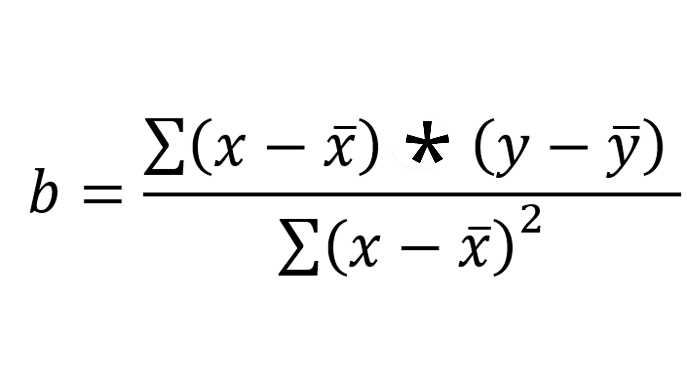
Least Squares
a = y̅-b x̅

Slide 7
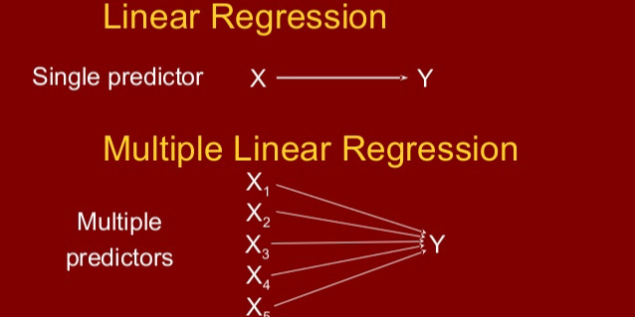
Simple and Multiple Linear Regression
Reference - https://hackernoon.com/

Slide 8
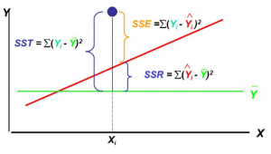
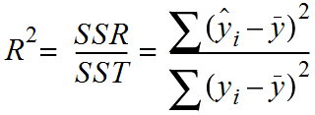
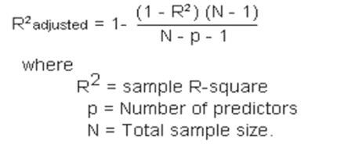

Evaluation Metrics
Reference - https://www.mathsisfun.com/

